Slide 1



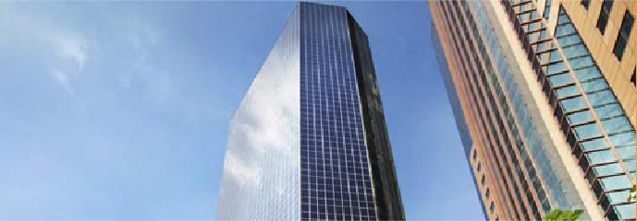

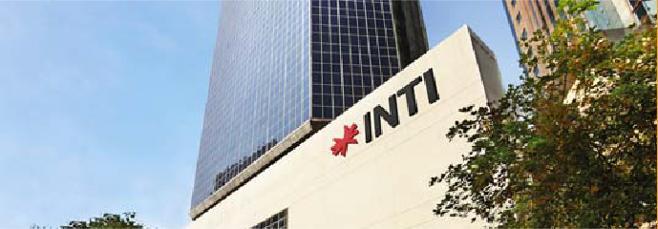

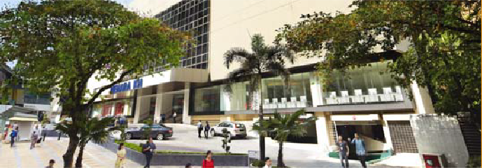




MENARA KH
 FULLY FITTED UNIT @ HIGH ZONE FLOOR
 ATTRACTIVE RENTAL
PROPERTY HIGHLIGHTS
Description | 35-storey office building Column free which allows maximum utilization of space. KL Monorail Station located infront of the building 24-hour security
Location | Jalan Sultan Ismail, Kuala Lumpur
Available Space | 31st Floor = 2,422 sq.ft. 32nd Floor = 2,540 sq.ft.
Rental Rate | RM5.50 per sq.ft.
Car park | 350 car park bay
Facilities | Food & Beverage outlet such as Heli Lounge Bar & Coffee Kiosk Convenient store Surau
Clinic & Dental Surgery
Amenities | Walking distance to KLCC, Pavilion, banks & City’s international class hotel
Accessibility Raja Chulan Monorail Station is at doorstep.
For more information, please contact us at:
G/L Kim
Vivian & Azira
: 03 – 2078 8988
: 010 – 3008 999
: 012 – 6030 898

Slide 2

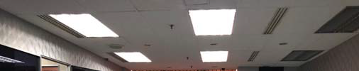
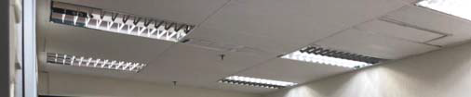

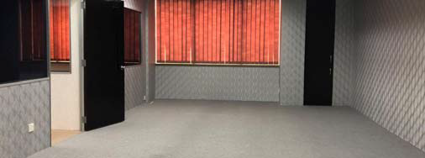
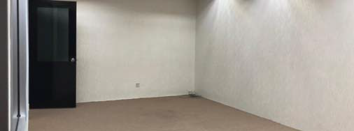






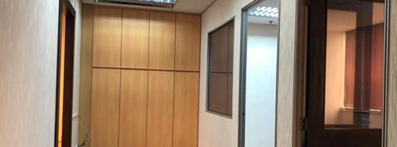
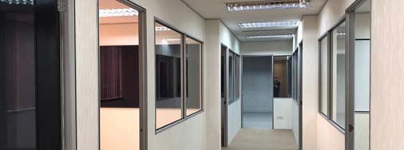

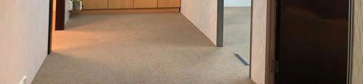
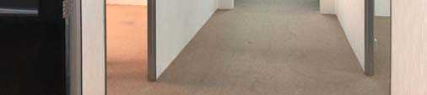


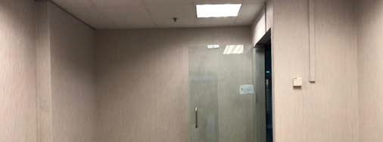
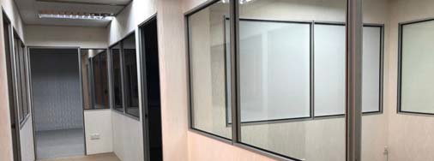

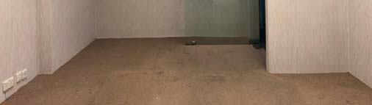
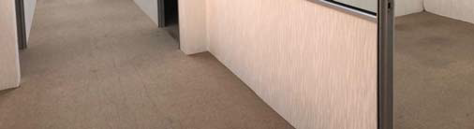
 Photograph – Suite 31.04, Level 31

Slide 3
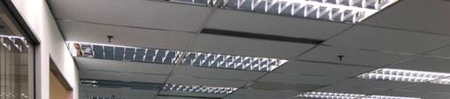
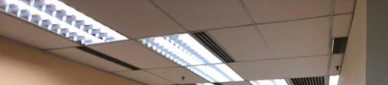
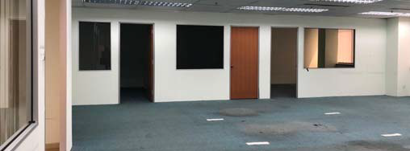
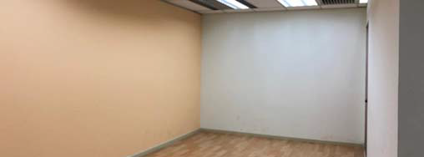




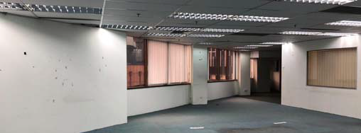
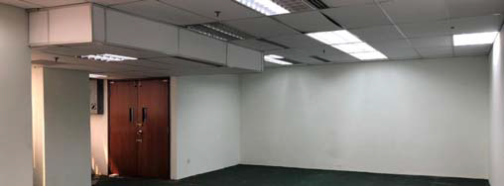
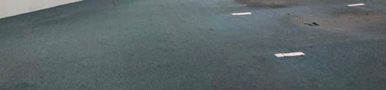
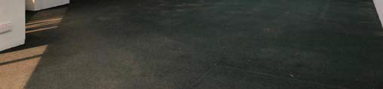
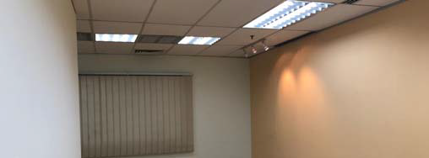
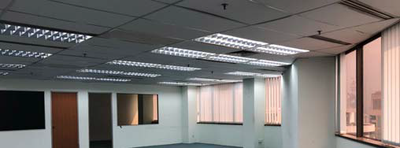
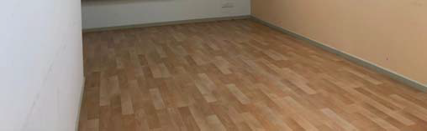
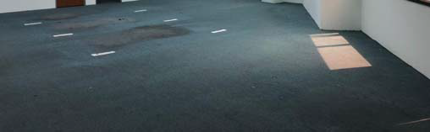
 Photograph – Suite 32.03, Level 32

